Slide 1

HYPERPARAMETER TUNING WITH REINFORCEMENT LEARNING
ÜMİT MERT ÇAĞLar
Mmı-702
Machine Learning for Multimedia Informatics
Lecturer: Elİf SÜRER

Slide 2
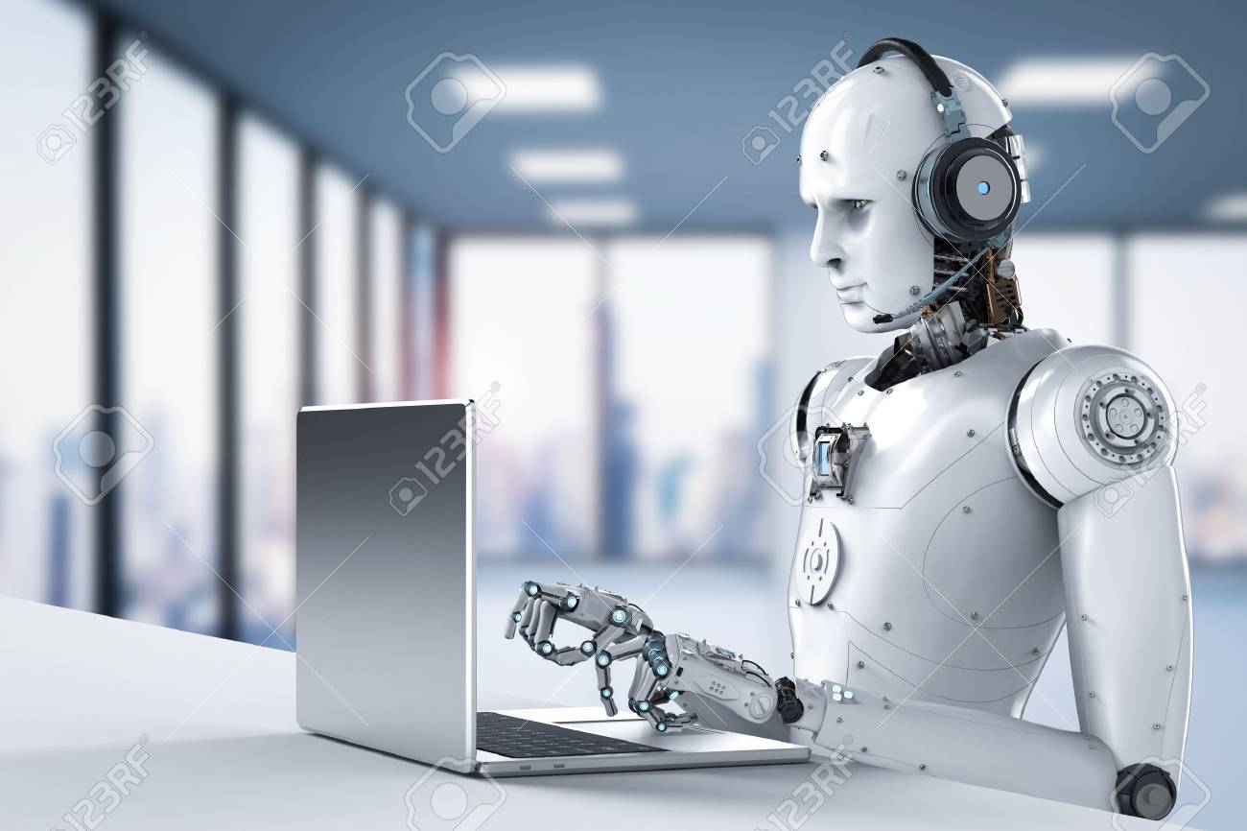
IDEA 1/2
Case study where a DL model is present
Tune hyperparameters for:
  Higher accuracy, precision and f1 scores
  Less overfitting
  Smaller resource requirements
  Faster training

Slide 3
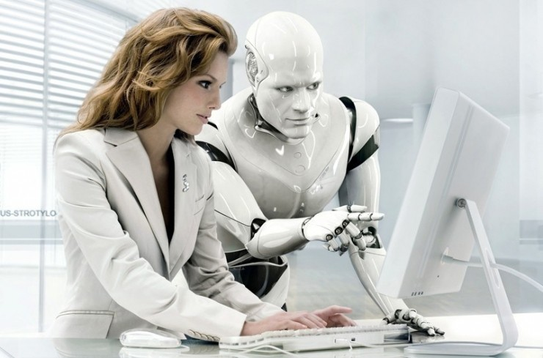
IDEA 2/2
Combine state-of-the-art deep learning techniques such as RNNs and GANs with RL
Hyperparameter tuning of DL methods with RL
Enable human interaction with the RL training process
Music generation as a service (planned as Django web service)

Slide 4
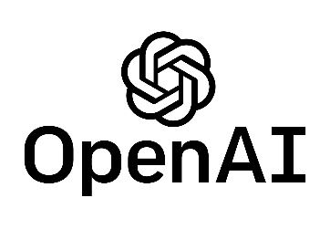
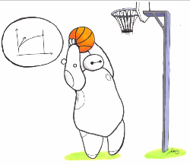

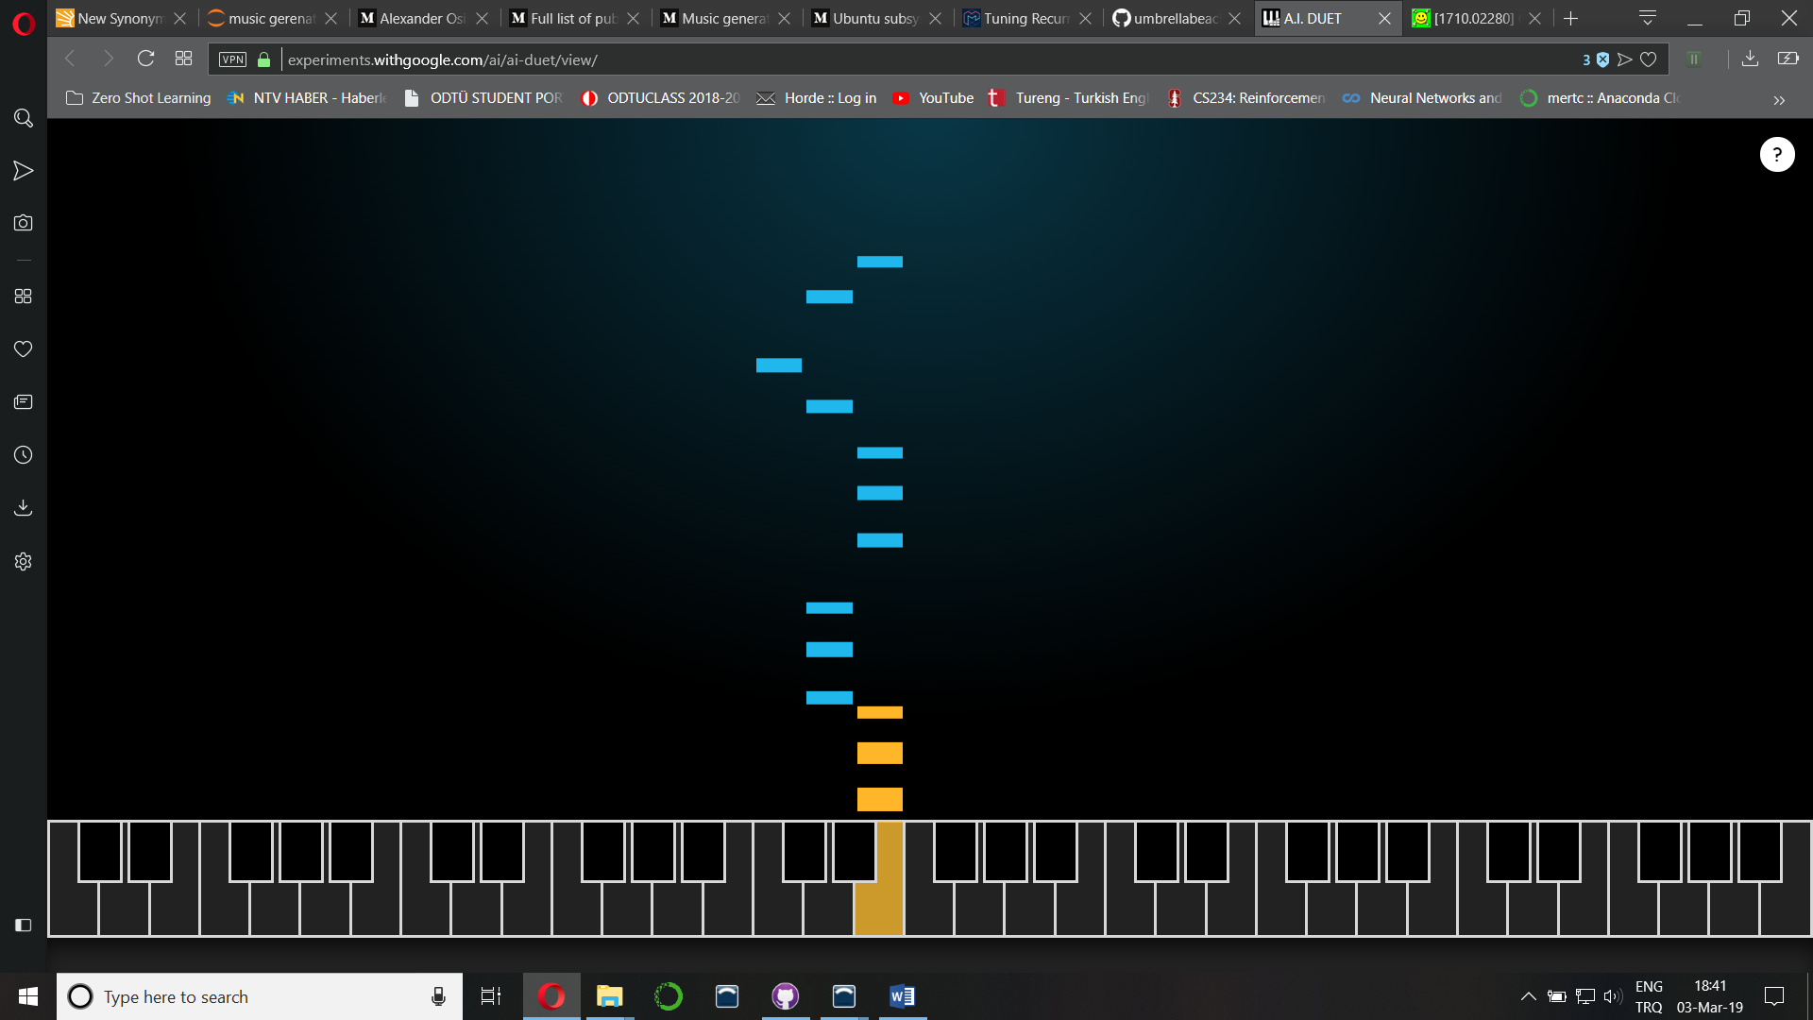
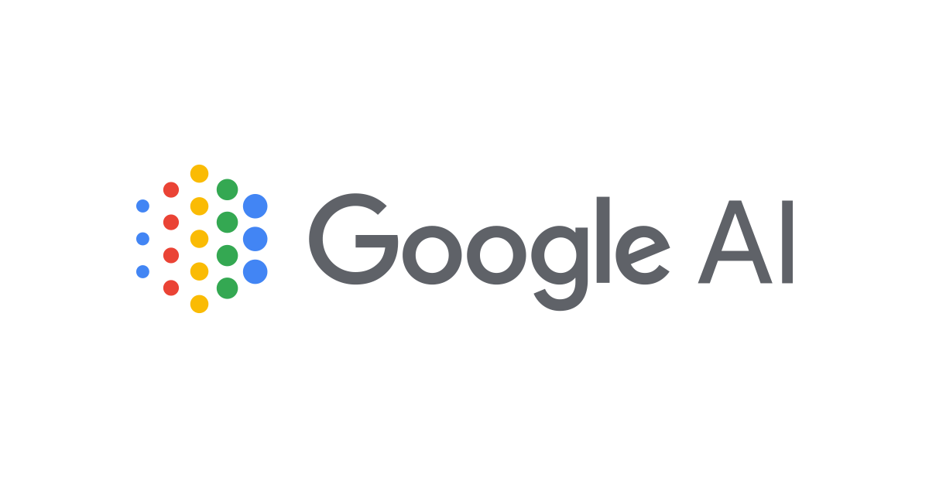
LITERATURE SURVEY
Open AI Baseline
Stable Baselines
Sliding Window in CNN
Magenta
Google AI’s Duet
https://github.com/umbrellabeach/music-generation-with-DL

Slide 5
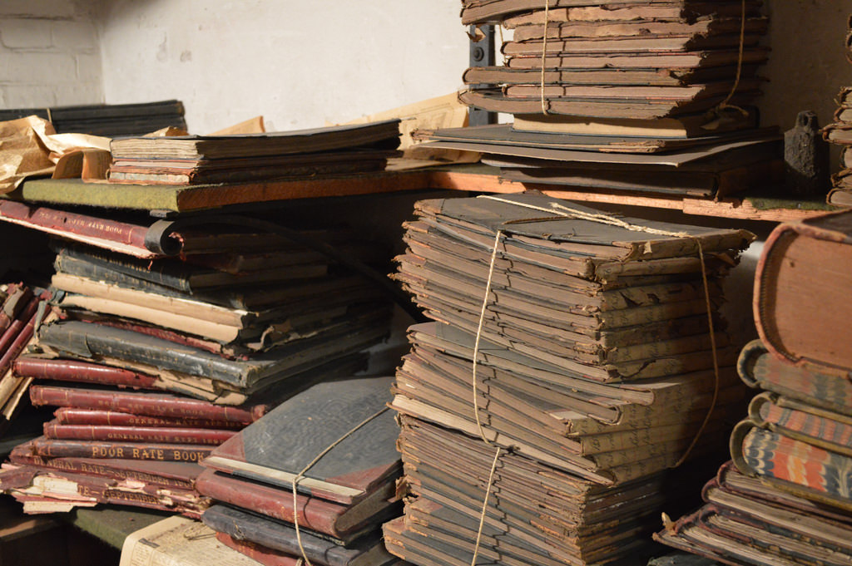
READING
Generating Music by Fine-Tuning Recurrent Neural Networks with Reinforcement Learning, Jaques
Generating Sequences with Recurrent Neural Networks, Alex Graves
DeepJ: Style-Specific Music Generation, Mao
Bach2Bach: Generating Music Using A Deep Reinforcement Learning Approach, Nikhil Kotecha
Generating Nontrivial Melodies For Music As A Service, Zhao et al.
Reinforcement Learning and the Creative, Automated Music Improviser, Benjamin D.

Slide 6
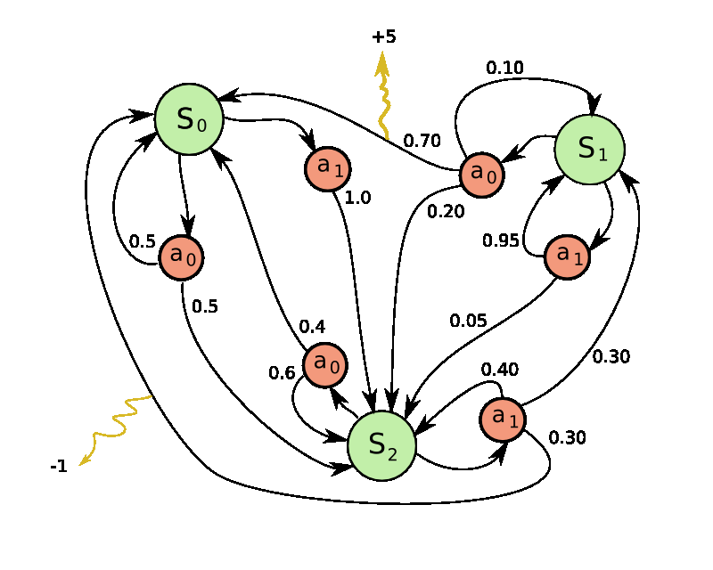
ALGORITHMS
Reinforcement Learning
  Q-Learning
  Markov Decision Processes (MDP)
  Bi-axial LSTM
  Temporal Difference Learning (TD)
Neural Networks for RL Tuning
  Recurrent Neural Networks
  Generative Adversarial Networks

Slide 7
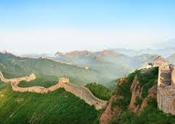
LIMITS
Outdated materials (1-3 years)
Music generation is a complex task
Requires both Reinforcement Learning and Deep Learning domain knowledge
User interface will be developed with Django/Flask (solid Python framework)

